Slide 1
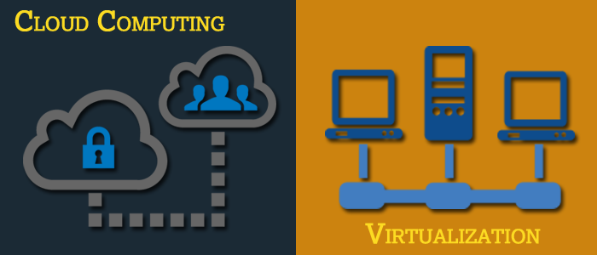
Basics of Virtualization and Cloud Technology

Slide 2
Chapter 2: Understanding Virtualization Technologies

Slide 3
Understanding Virtualization Technologies
Server Virtualization
Operating System Virtualization
Hardware Emulation and Paravirtualization
Client Virtualization
Application Packaging and Application Streaming
Storage Virtualization

Slide 4
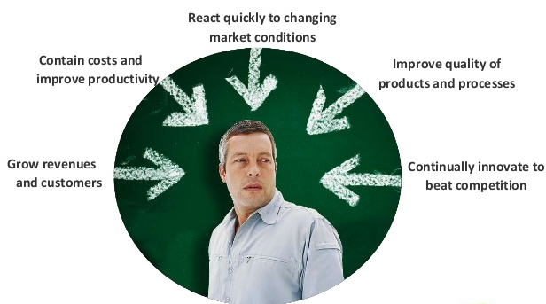
Top Business Challenges Lead to Virtualization of Servers in IT
Source: https://image.slidesharecdn.com/theevolutionofservervirtualization

Slide 5
IT Needs and Challenges
Needs | Challenges
Bigger, faster and available virtual machines | Keep services up and running and meet the Service Level Agreements (SLAs)
Greater flexibility and agility to deliver solutions | Decrease capital and operational costs of infrastructure
Ability to handle complex storage and networking requests | Use bigger, capable servers effectively
Removal of limits in mobility of virtual machines | Protect and use existing investments and infrastructure
Support for new hardware technologies | Maintain separation of resources in multi-tenant environments

Slide 6
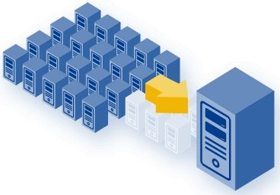
Why Server Virtualization?
Most servers in the IT industry operate at less than 15 percent of capacity, leading to server sprawl (server sprawl is described a set of situations that can occur in data centres resulting in poor hardware resource utilisation, poor system and software level security and wasted energy) and complexity.
Server virtualization addresses these inefficiencies by allowing multiple operating systems to run on a single physical server as virtual machines, each with access to the underlying server's computing resources.
The next step is to aggregate a server cluster into a single consolidated resource that improves overall efficiency and reduces cost. Server virtualization also enables faster workload deployment, increased application performance and higher availability.
Source: https://it-services.techstarters.com/media/xserver-virtualization.jpg.pagespeed.ic.9iHxFGhuQw.jpg

Slide 7
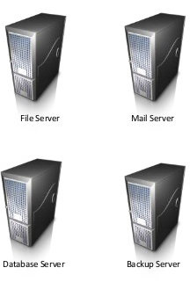
Traditional Approach
One Application, one server relationship
Software and hardware are tightly coupled
Underutilised resources introduce real cost into the infrastructure

Slide 8
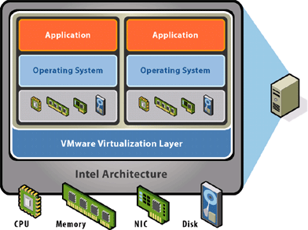
Virtualized Approach
Physical hardware is abstracted by a virtualization layer or hypervisor
Manage operating system and an application as a single unit by encapsulating them into virtual machines
Optimise resource utilisation rate compared to traditional approach
Source: https://www.dominant-it.com/wp-content/uploads/2011/03/chart_server_virtualization.gif

Slide 9
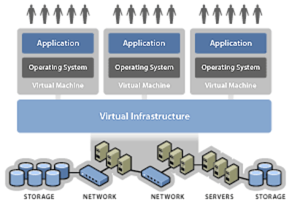
What is Server Virtualization?
In creating a virtual server, the process is also known simply as server virtualization. It means partitioning a physical server into smaller virtual servers to maximise the resources of the dedicated server.
Through server virtualization, the resources of the server itself are hidden or masked from users each of who have their own separate and independent virtual machine to utilise.
The server administrator uses software that divides the physical server into multiple isolated virtual environments while masking resources from the users, such as the number and identity of individual physical servers, processors and operating systems.
Source: http://searchservervirtualization.techtarget.com/definition/server-virtualization

Slide 10
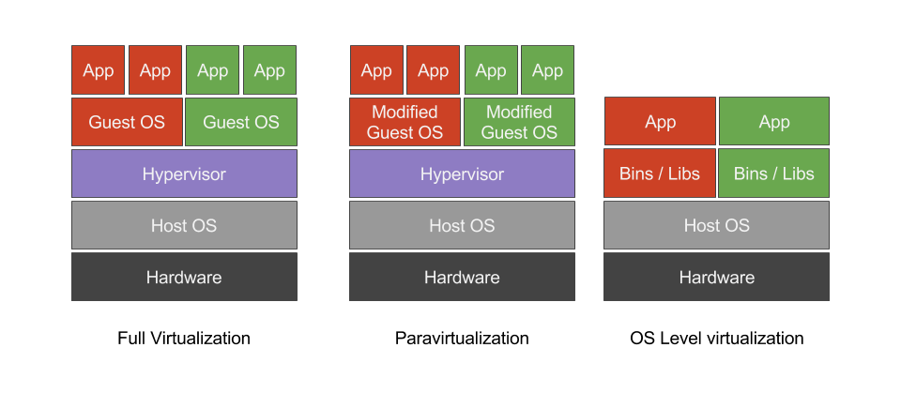
Different Types of Server Virtualization
Figure: Showing Different Types of Virtualization
Image Source: blog.fntlnz.wtf

Slide 11
Full Virtualization
Full virtualization uses a hypervisor as a special kind of software to allocate resources.
The hypervisor interacts directly with the physical server and works as a platform for each virtual server’s operating system
The hypervisor also works to keep each virtual machine independent and unaware of other virtual servers running on the physical machine
Each guest server runs its own OS while the hypervisor monitors the resources of the physical server and relays these resources to the appropriate virtual server
Some of the physical server’s processing power must be reserved for the hypervisor’s needs
Source: http://www.netstandard.com/virtual-servers-work/
Image Source: blog.fntlnz.wtf

Slide 12
Paravirtualization
In paravirtualization, guest operating system or virtual servers are aware of one another, unlike in the full virtualization approach.
The hypervisor does not require as much processing power to manage the virtual servers as it would under full virtualization, which can help prevent any slowing down of the performance.
The hypervisor does not play as big a role because each OS is already aware of the demands the other operating systems are placing on the server.
This makes it possible for the whole system to work together as a unit rather than the hypervisor relaying resources and having to monitor what resources are available for each virtual server.
Source: http://www.netstandard.com/virtual-servers-work/
Image Source: blog.fntlnz.wtf

Slide 13
Operating System Level Virtualization
OS (Operating System) level virtualization uses a completely different architecture than the other two.
OS level virtualization does not even use a hypervisor at all because virtualization capability is part of the host OS which performs that kind of functions that a fully virtualized hypervisor would.
There are limitations to this method though as all the guest or virtual servers run on the same OS.
The virtual servers remain independent of one another, but users are not able to mix and match operating systems among them.
This environment is known as homogeneous since all the operating systems are the same. The type of virtualization that would work best depending on the network administrator’s needs.
Source: http://www.netstandard.com/virtual-servers-work/
Image Source: blog.fntlnz.wtf

Slide 14

Benefits of Server Virtualization
More efficient utilisation rates
Reduced power consumption and energy costs
Decreased capital expenditures
Enhanced business continuity
More flexible and efficient allocation of resources
Simplified server management and security
First step towards the cloud environment

Slide 15
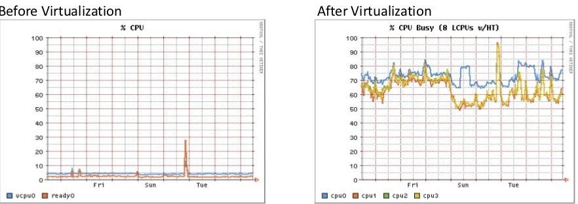
More Efficient Utilisation Rate
X86 servers typically run at utilisation rates of 5 to 15%
Virtualization enables businesses to increase server virtualization rate from 60 to 80 %
Halts to server sprawl
Dynamic resource balancing and resulting in improved operating system and application performance
Image Source: VMware Solutions Brief: VMware Solutions for SMB

Slide 16

Reduced Power Consumption
Underutilised x86 hardware is the most significant factor contributing to excessive energy consumption in data centres
Gartner Report: Even underutilised servers use high amounts of energy. Increasing utilisation levels to 60% and more requires only modest increases in power. The effective use of virtualization can reduce server energy consumption by up to 82% and floor space by 85%
Virtualization right sizes these major contributors to excessive data centre energy consumption
Greener approach to IT, enables organisations to demonstrate environmental responsibility
Source: https://www.slideshare.net/mhitendra/the-evolution-of-server-virtualization-by-hitendra-molleti

Slide 17

Decreased Capital Expenditures
Consolidating of servers, enables efficient use of combined infrastructure resources and breaks away from the traditional model of one server for each application
Simplified migrations, when an OS is tied directly to a piece of hardware, it is complex and costly to migrate
Facilitates operational expenditure savings over a long period of time
Accelerates Return On Investment (ROI)
Frees up servers for deployment as backup system at remote site

Slide 18

Enhanced Business Continuity
Virtualization makes it affordable and efficient to deploy a backup system at a remote site
Reduced Backup and recovered time, that is, ease of backing up and restoring a file
Lower cost and management complexity while enhancing efficacy of business continuity plan

Slide 19
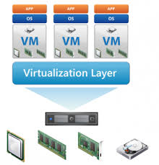
More Flexible Use of Resources
Server Virtualization infrastructure brings uniformity to the data centre
Rapid provisioning of servers and applications within minutes, instead of weeks
Dynamically scale to respond to unpredictable market changes and user demands
Increase in productivity of IT administrators, enabling them to spend more time focusing on business needs
Lower IT costs through increased efficiency, flexibility and responsiveness

Slide 20

Simplified Server Management and Security
Accelerated Application Testing and Deployment, by using pre-configured VM templates and profiles
Centralised Resource Monitoring (VMM) and dynamically map computing resources to the environment
Seamless upgrade/maintenance of hardware with zero down time
Guest isolation, one guest Virtual Machine (VM) cannot access or even address the “hardware resources” of another guest VM or the host/hypervisor

Slide 21
More Details on Operating System Virtualization
What is Operating System Virtualization?
Operating system virtualization (OS virtualization) is a server virtualization technology that involves tailoring a standard operating system so that it can run different applications handled by multiple users on a single computer at a time.
The operating systems do not interfere with each other even though they are on the same computer.
In OS virtualization, the operating system is altered so that it operates like several different, individual systems.
The virtualized environment accepts command from different users running different applications on the same machine. The users and their requests are handled separately by the virtualized operating system.
It is also called OS-level virtualization; it is a type of virtualization technology which works on OS layer. Here the kernel of an OS allows more than one isolated user-space instances to exist. Such instances are called containers/software containers or virtualization engines.
In other words, OS kernel will run a single operating system and provide that operating system’s functionality to replicate on each of the isolated partitions.
Source: https://www.techopedia.com/definition/660/operating-system-virtualization-os-virtualization

Slide 22
Uses of OS Virtualization
Used for virtual hosting environment
Used for securely allocation of finite hardware resources among a large number of distrusting users
System administrator uses it to integrate server hardware by moving services on separate hosts
To improvise security by separating several applications to several containers
These forms of virtualization don’t require hardware to work efficiently.

Slide 23
Advantages OS Virtualization
Flexible Provisioning of Resources
Support of Multiple Images per System, including Boot Menu
Rapid Software (OS/Apps) Deployment
Easy Implementation of Updates and Hotfixes of the Operating System and Applications
Easy Rollback Scenarios
After Restarting, the System is Back to a Clean State
Source: http://techgenix.com/introduction-os-virtualization-part2/
Notes:
Flexible Provisioning of Resources : With OS Virtualization, you can easily connect different virtual disks to a system. The client can easily start another operating system or another role. Also, workstations or servers can be assigned with a specific role when needed by assigning another virtual disk (also known as on-demand capacity or hardware re-purposing).
Support of Multiple Images per System, including Boot Menu: The extended flexible provisioning may be taken a step further with the possibility of assigning multiple images to one client simultaneously. When starting, a boot menu could also be presented to the client, so that the end-user can choose which operating system (with a different role) will be started. In this case, a system could be used for several purposes within seconds.
Rapid Software (OS/Apps) Deployment: Adding a new server or workstation to the infrastructure takes just a few minutes. Instead of installing and configuring the system manually or via a deployment tool, taking at least a few hours, with just a few steps, the client is assigned to a virtual disk and can be used in production.
Easy Implementation of Updates and Hotfixes of the Operating System and Applications: With OS virtualization, an update or hotfix should just be added to the virtual disk image (VDI) instead of all servers. Therefore, one can create a new virtual disk which includes the update or hotfix and test it easily by assigning this virtual disk to one machine. If the tests are successful, this virtual disk can be assigned to all the other clients. One needs to create procedure/systems to manage the updates and different virtual disk versions.
Easy Rollback Scenarios: Although the update or hotfix was tested thoroughly, during production the behaviour of this hotfix/update is not as expected. By assigning the previous virtual disk to those clients and restarting them you can revert to the previous state easily and quickly.
After Restarting, the System is Back to a Clean State: This advantage only applies to shared images. If your system is behaving strangely, often a complete re-installation is the only possible solution. With OS virtualization (in combination with the shared disk) a machine only needs to be restarted to load the default configuration again.

Slide 24
Disadvantages OS Virtualization
Following are some of the disadvantages of OS virtualization:
No Work offline Capability
High-speed LAN Recommended (>100Mb)
Not All Operating Systems are Supported
Notes:
No Work offline Capability: At the moment OS virtualization products must be connected with the OS virtualization server to use the operating system on the virtual disk. When no network connection is available the system cannot be used.
High-speed LAN Recommended (>100Mb): Because the virtual disk is connected from the OS virtualization server via the network interface card a LAN is recommended. Over a WAN connection there is probably not enough bandwidth available and/or not reliable enough to use the system smoothly.
Not All Operating Systems are Supported: Although many operating systems are supported, there are some Linux distributions which cannot run via the OS virtualization technique.

Slide 25
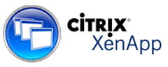
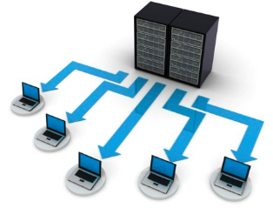
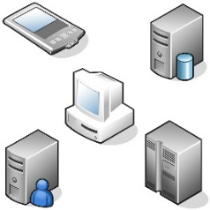
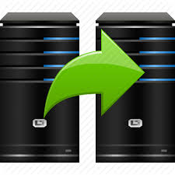

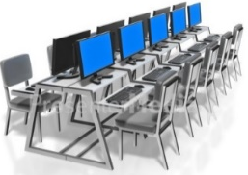
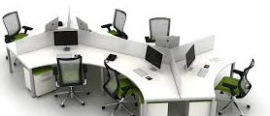

OS Virtualization Scenarios
Citrix XenApp/Terminal Servers
VDI/DDI Solutions
Web Servers
Back-up Servers
Lab Environments
Educational Environments
Public Workstations
Secure Environments
Source: http://techgenix.com/introduction-os-virtualization-part2/
Notes:
1. Citrix XenApp/Terminal Servers OS virtualization is a nice complementary solution for Citrix XenApp/Terminal Server Based infrastructures. One of the greatest challenges of these infrastructures is to keep the server 100% identical for a consistent user experience. By using the shared virtual disks after every reboot, the terminal server is back in his default state and changes are applied to all servers.
2. VDI/DDI Solutions
Virtual desktop infrastructure solutions are also becoming increasingly popular. One of the biggest disadvantages of most VDI products is the need for expensive (Storage Area Network) SAN storage to host the virtual machines. With the OS Virtualization shared disk mechanism, the virtual machines can use the same virtual disk and no expensive disk space is needed on the SAN.
3. Web Servers
Most web servers are pretty static and do not save data locally. Also, the need for web resources can be very different during the day. With flexible provisioning, the needed resources can be assigned during the day, for example sharing the hardware with another role.
4. Back-up Servers
Back-up servers are normally used for a few hours a day (during non-business hours). Therefore, the hardware is relatively unused for most of the time. Using flexible provisioning, the hardware may be used for other roles during business hours and after that “assigned” to the back-up server role virtual disk for the back-up process.
5. Lab Environments
An attribute of lab environments is the need to restore the status of the environment to the default state quickly so the students can successfully run the exercises. OS virtualization can provide that with the shared disk option and it can also have “flexible provision” for the system with the correct lab environment.
6. Educational Environments
In educational environments, it is always a challenge to offer fully functioning workplaces for all the students. Also, depending on the training given there can be the need for several operating systems. Using OS Virtualization with multiple virtual disks assigned, a student can use the boot menu to start the relevant environment for his/her training. Also, after restarting, the machine is in its default state again (when using shared virtual disks).
7. Public Workstations Just like educational environments, public workstations should always offer functionality and no personal information should be stored.
8. (Very) Secure Environments OS Virtualization is also a technique that can be used for (highly) secure environments. For example, if a machine is stolen (which uses OS Virtualization) no data is available on this machine.

Slide 26
Hardware Emulation and Paravirtualization
What is hardware emulation?
Hardware emulation is a specialised software, which is also known as hypervisor, creates hardware emulation for OS in a single server. They can host different types of OS in a single server. The OS loaded into each virtual machine works as a standalone and unmodified OS. When a VM is running, the hypervisor makes changes to the part of the OS that makes system calls. Hypervisor changes the OS by entering a piece of code which is known as binary translation to the OS when it is running. Binary translation takes place in four parts of the OS ( memory, processor, network and storage) that interact with the hardware.
Advantage
You do not have to modify the OS and applications to run on the virtual environment.
Two types of hypervisor is used in hardware emulation:
Type 1 hypervisor
Type 2 hypervisor
Source: https://securitywing.com/types-virtualization-technology/

Slide 27
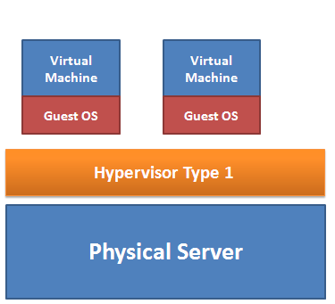
Hardware Emulation and Paravirtualization continued…
Type 1 Hypervisor
Type 1 hypervisor is also known as bare-metal implementation because they sit directly on the top of hardware, without needing any operating system. Since they can directly communicate with hardware resources, they are much faster than type 2 hypervisor.
Advantage of Type 1:
If a single virtual machine crashes, it does not affect the rest of the guest operation system. Therefore, they are considered more secure than type 2. Since they generate less overhead, type 1 hypervisor is much faster than its counterpart.
Type 1 Products include VMware ESX, Microsoft Hyper-V, and the many Xen variants.
Source: https://securitywing.com/types-virtualization-technology/

Slide 28
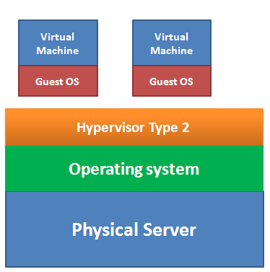
Hardware Emulation and Para Virtualization continued…
Type 2 Hypervisor
Type 2 hypervisor resides on top of the operating system. Since they cannot directly communicate with the hardware, they are less efficient than the type 1.
Advantage of Type 2
In type 2 hypervisor, the OS takes care of all the hardware. That is why a type 2 hypervisor can support a wide range of hardware. Besides, installing a type 2 is much easier than that of type 1.
Disadvantage of Type 2
They have more points of failure since anything that affect the stability of the base operating system can also affect the guest OS and the virtual machine. When the base OS needs a reboot, all the VM will also be rebooted.
Example of Type 2 Hypervisor
VMware Player, VMware Workstation and Microsoft Virtual Server
Source: https://securitywing.com/types-virtualization-technology/

Slide 29
Hardware Emulation and Para Virtualization Continued…
What is paravirtualization?
Paravirtualization is a virtualization technique that provides an interface to virtual machines that are similar to their underlying hardware. In paravirtualization, the guest operating system is explicitly ported before installing a virtual machine because a non-tailored guest operating system cannot run on top of a virtual machine monitor (VMM).
Paravirtualization has many significant performance advantages and its efficiencies offer better scaling. As a result, it is used in various areas of technology, such as:
Partitioning development environments from test systems
Disaster recovery
Migrating data from one system to another
Capacity management
Paravirtualization technology was introduced by IBM and was developed as an open-source software project.
Example: Xen open source virtualization software
Source: https://www.techopedia.com/definition/16816/paravirtualization
Notes:
Paravirtualization enables several different operating systems to run on one set of hardware by effectively using resources, such as, processors and memory. In paravirtualization, the operating system is modified to work with a virtual machine. The intention behind the modification of the operating system is to minimise the execution time required in performing the operations that are otherwise difficult to run in a virtual environment.

Slide 30

Client Virtualization
According to a Research and Markets report, client virtualization is expected to drive continual growth in the IT sector. Long gone are the days of tedious one-on-one interaction between servers and systems, it is now the time to embrace the automated and virtualized alternative.
What is client virtualization?
Client virtualization simulates a user's desktop experience, but separates the desktop from the hardware, OS and applications. The simulated client desktop or virtual machine (VM), runs on a physical host server which is running virtualization software called a hypervisor. Many virtual clients can run on one host server with each client having different user properties, data, applications and even operating systems. This allows users to seamlessly access their regular desktops from inexpensive low-end, thin-client or shared machines.
Types of Client Virtualization
Presentation virtualization
Virtual desktop infrastructure (VDI)
Application virtualization
Source: http://www.techadvisory.org/2016/06/the-three-types-of-client-virtualization/

Slide 31
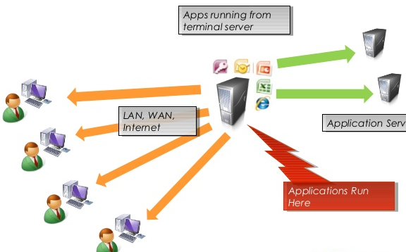
Presentation Virtualization
As hinted in the name, it is an application delivery method that delivers desktops or applications from a shared server.
This enables access to client applications from a central server that is connected with clients. This initiates a presentation session through a web portal while giving them access to a virtualized application instance on a shared Windows Server OS. The only resources shared with the client is the graphical user interface as well as the mouse/keyboard.
Benefits of this presentation virtualization range from reduced user resource needs to simplicity, since applications are installed only once despite multiple users sharing the same application instance and even server level administration since multiple users are sharing the resources of the same system.
Source: http://www.techadvisory.org/2016/06/three-client-level-virtualization-options/

Slide 32
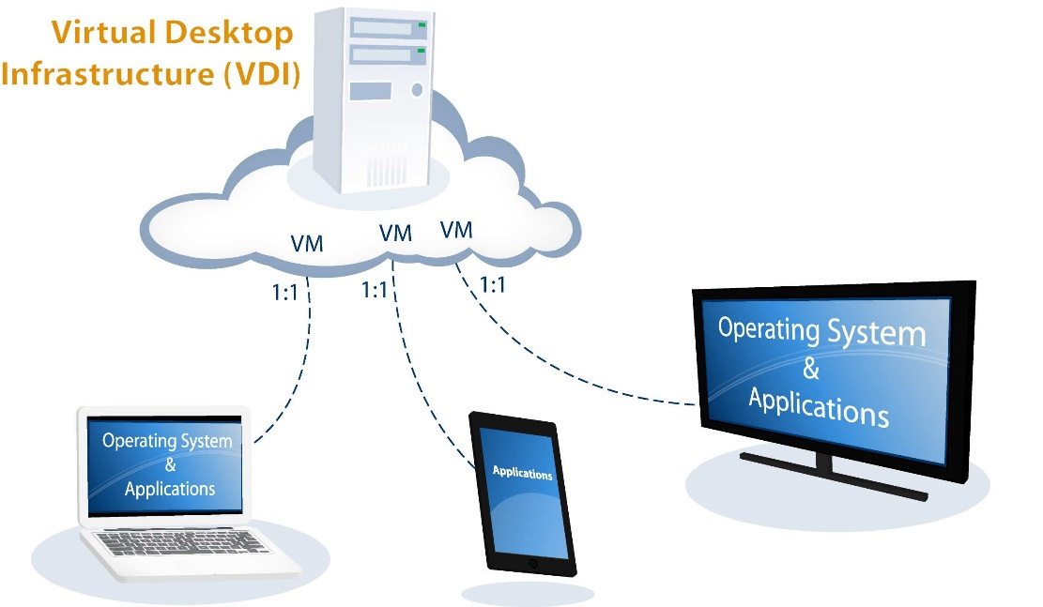
Virtual Desktop Infrastructure (VDI)
Sharing similarities with presentation virtualization, VDI solutions are also a remote display protocol that hosts centrally-managed virtual machines (VMs) that client PCs are connected to on a one-on-one network relationship.
Also known as desktop virtualization, this method utilises a hypervisor that is in charge of hosting a dedicated operating system VM for each client individually.
Due to the fact that each client is totally separate from one another on the server, this option allows for flexibility, management and security.
Source: http://www.techadvisory.org/2016/06/three-client-level-virtualization-options/

Slide 33
Why VDI?
It saves the money as it has smaller software licensing requirements and it also reduces the need for staff to manage and troubleshoot problems.
It also allows for secure mobile access to applications by enabling hardware-based GPU sharing through a secure connection from any device as well as better desktop security thanks to customisable permissions and settings.
It allows for easier maintenance after logging off at the end of the day, the desktop can be reset wiping clean any downloaded software customisations.

Slide 34
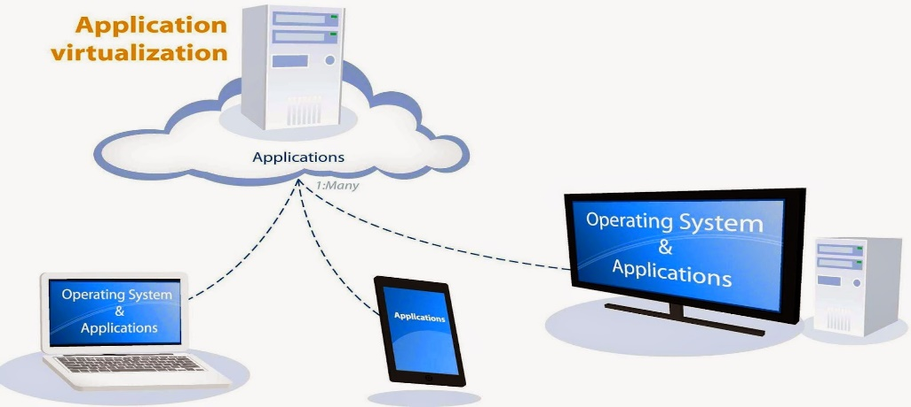
Application Virtualization
Application virtualization is the separation of an installation of an application from the client computer accessing it.
From the user's perspective, the application works just like it would if it lived on a user's device. The user can move or resize the application window, as well as carry out keyboard and mouse operations. There might be subtle differences at times, but for the most part, the user should have a seamless experience.
To make this possible, IT must use an application virtualization product. Application virtualization vendors and their products include Microsoft App-V, Citrix XenApp, Parallels Remote Application Server and VMware ThinApp or App Volumes.
Benefits of Application Virtualization
Application virtualization can be an effective way for organisations to implement and maintain their desktop applications. One of the benefits of application virtualization is that administrators only need to install an application once to a centralised server rather than to multiple desktops.
Source: http://www.techadvisory.org/2016/06/three-client-level-virtualization-options/

Slide 35
Client virtualization is also classified into three flavours as mentioned in the figure given below:
Client Virtualization
Application Packaging
Application Streaming
Classification of Client Virtualization with Respect to Application

Slide 36
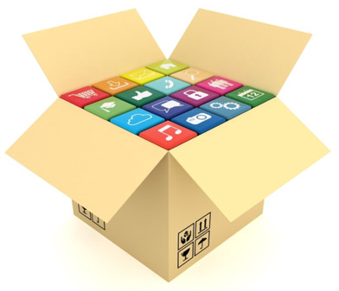
Application Packaging
In application packaging, virtualized environment is packed along with the application; so that the underlying hardware and the OS resources will not be attacked with malware/virus.
Although the specifics of how application packaging is accomplished vary from one vendor to another, all the methods share a common approach, that is, isolating an application that runs on a client machine from the underlying operating system. By isolating the application from the operating system, the application is unable to modify underlying critical operating system resources, making it much less likely that the OS will end up compromised by malware.
Application packaging is accomplished by executing the application on top of a software product that gives each application its own virtual set of system resources, such as, files and registry entries. Another approach of accomplishing application packaging is by bundling the application and the virtualization software into a single executable program that is downloaded or installed. Application packaging is a great way to isolate programs from one another and reduce virus transmission.
Products that provide application packaging include:
SVS from Altiris
Thinstall’s Virtualization Suite
Microsoft’s SoftGrid

Slide 37
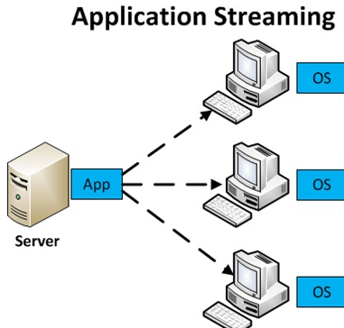
Application Streaming
It stores the proper versions of applications on servers in the data centres. Whenever an end user wants to use a particular application, it is downloaded on the fly to the end user’s machine.
Application packaging is a great way to isolate programs one another and reduce virus transmission, but it doesn’t solve the problem of end users installing non-packaged software on client machines.
Application streaming solves the problem of how to keep client machines loaded with up-to-date software in a completely different fashion than application packaging. Because it’s so difficult to keep the proper versions of applications installed on client machines, this approach avoids installing them altogether. Instead, it stores the proper versions of applications on servers in the data centre and when an end user wants to use a particular application, it is downloaded on the fly to the end user’s machine.
Examples of these situations include call centres and office environments where workers rarely leave the premises to perform work duties. This type of virtualization is offered by AppStream’s Virtual Image Distribution, Softricity’s SoftGrid for Desktops and Citrix’s presentation server.
Application streaming is best suited for static work environments where people don’t move around much, such as, call centres and form-processing centres.
Source: https://en.vcenter.ir/application/application-streaming/

Slide 38
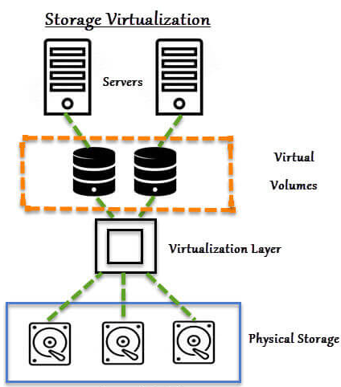
Storage Virtualization
The amount of data that organisations are creating and storing is exploding. Due to the increasing shift of business processes to web-based digital applications, every company is being inundated with data.
The explosion of data is causing the following problems for many such companies:
For a sheer storage capacity, many applications generate more data that can be stored physically on a single server.
Many applications particularly Internet-based ones have multiple machines that need to access the same data. Having all the data residing on one physical machine creates a bottleneck, not to mention the potential risk of a situation where many virtual machines might be made inoperable if a single physical machine containing all the application’s data crashes.
For the above two reasons, data has moved into virtualization. Moving data from many physical servers to a central location enables backups to be performed more efficiently. Furthermore, the central data repository can be configured with multiple physical storage devices to ensure that no hardware crash will ever make an organisation’s data unavailable.
Source: storagetutorials.com

Slide 39


